Slide 1
Halloween
Konverzace v anglickém jazyce
8.-9. ročník
Autorem materiálu je Mgr. Alexandra Kubátová,
ZŠ Dobříš, Komenského nám. 35, okres Příbram
Inovace školy – Dobříš, EUpenizeskolam.cz

Slide 2
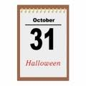
1. What day is Halloween celebrated?
On the 31st October.

Slide 3
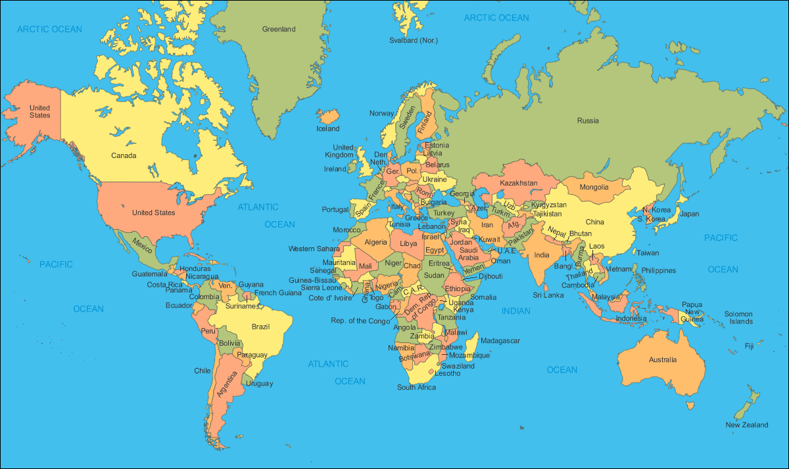
2. Where is Halloween celebrated?
United Kingdom
Canada
USA
Australia
New Zealand

Slide 4
3. Is it a public holiday in the UK?
No, it isn‘t.

Slide 5
4. How do usually people get dressed up on this day?
They get dressed up as witches, ghosts, goblins, vampires, skeletons…

Slide 6
5. What are traditional party decorations?
Pumpkin lanterns and decorations of bats, spiders and black cats.

Slide 7
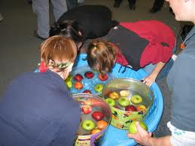
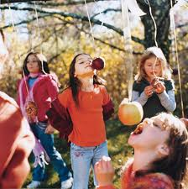
6. Say the names of the two traditional games played on Halloween?
Apple bobbing and apples on strings.

Slide 8
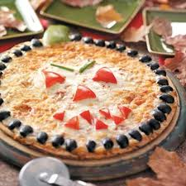
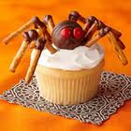
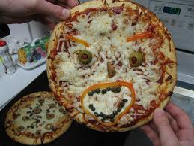
7. What does traditional Halloween food look like?
Special Halloween food is decorated to look scary, like creepy cupcakes or scary pizza faces.

Slide 9
8. What must the person who opens the door and chooses the TREAT offer?
He/she must offer sweets or chocolate.

Slide 10

9. What does the word Halloween mean?
So Halloween means the evening before ALL HOLY ONES DAY (ALL SAINTS DAY).
It comes from a corruption of ALL HALLOW‘S EVE. HALLOW means holy ones or saints. EVE means the evening before.

Slide 11
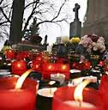

10. How do we call ALL SAINTS DAY in Czech and when do we celebrate it?
We call it DUŠIČKY and we celebrate it on 2nd November.

Slide 12
11. Why do people get dressed up as ghosts and witches on Halloween?
In order to frighten away all bad spirits.

Slide 13
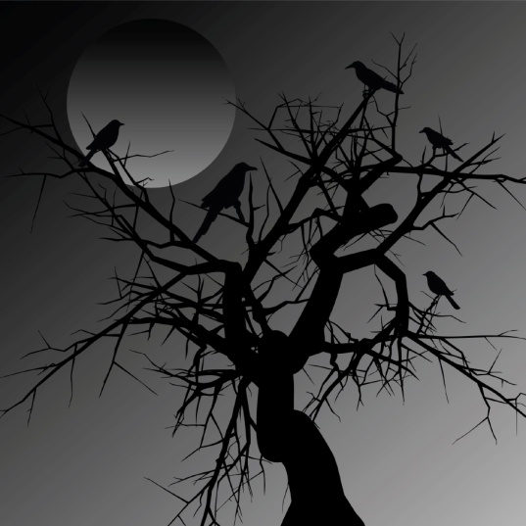

12. Where probably the custom of the pumpkin lantern come from?
It probably comes from Irish folklore. There is a story about a man called Jack who made a pact with the devil.

Slide 14
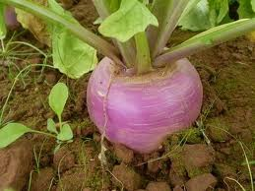
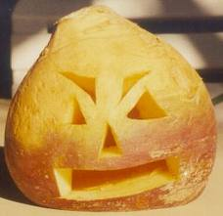
13. What kind of vegetable was originally used for making lanterns?
It was a turnip.

Slide 15




14. How are the lanterns made of pumpkins called now?
They are called JACK-O-LANTERNS.

Slide 16
Zdroje:
Bradshaw, Coralyn: This is Britain: Activity Book. Level 1. Oxford: OUP. 2009. 41 pages. ISBN: 978-0-19-459366-3
Následující obrázky z internetu byly staženy dne 4.7.2011:
http://www.worldmapsphotos.com/world-map-2/
halloweeninpinelands.yolasite.com
http://l.thumbs.canstockphoto.com/canstock5511786.jpg
gossiprocks.com
jmilblogsapparently.blogspot.com
zomboscloset.com
farmfreshveggies.blogspot.com
radio.cz
uncyclopedia.wikia.com
wpclipart.com
Ostatní obrázky: klipart aplikace Microsoft Office Power Point 2007

Slide 17
Notes:
Pracovní list k vytištění

Slide 18
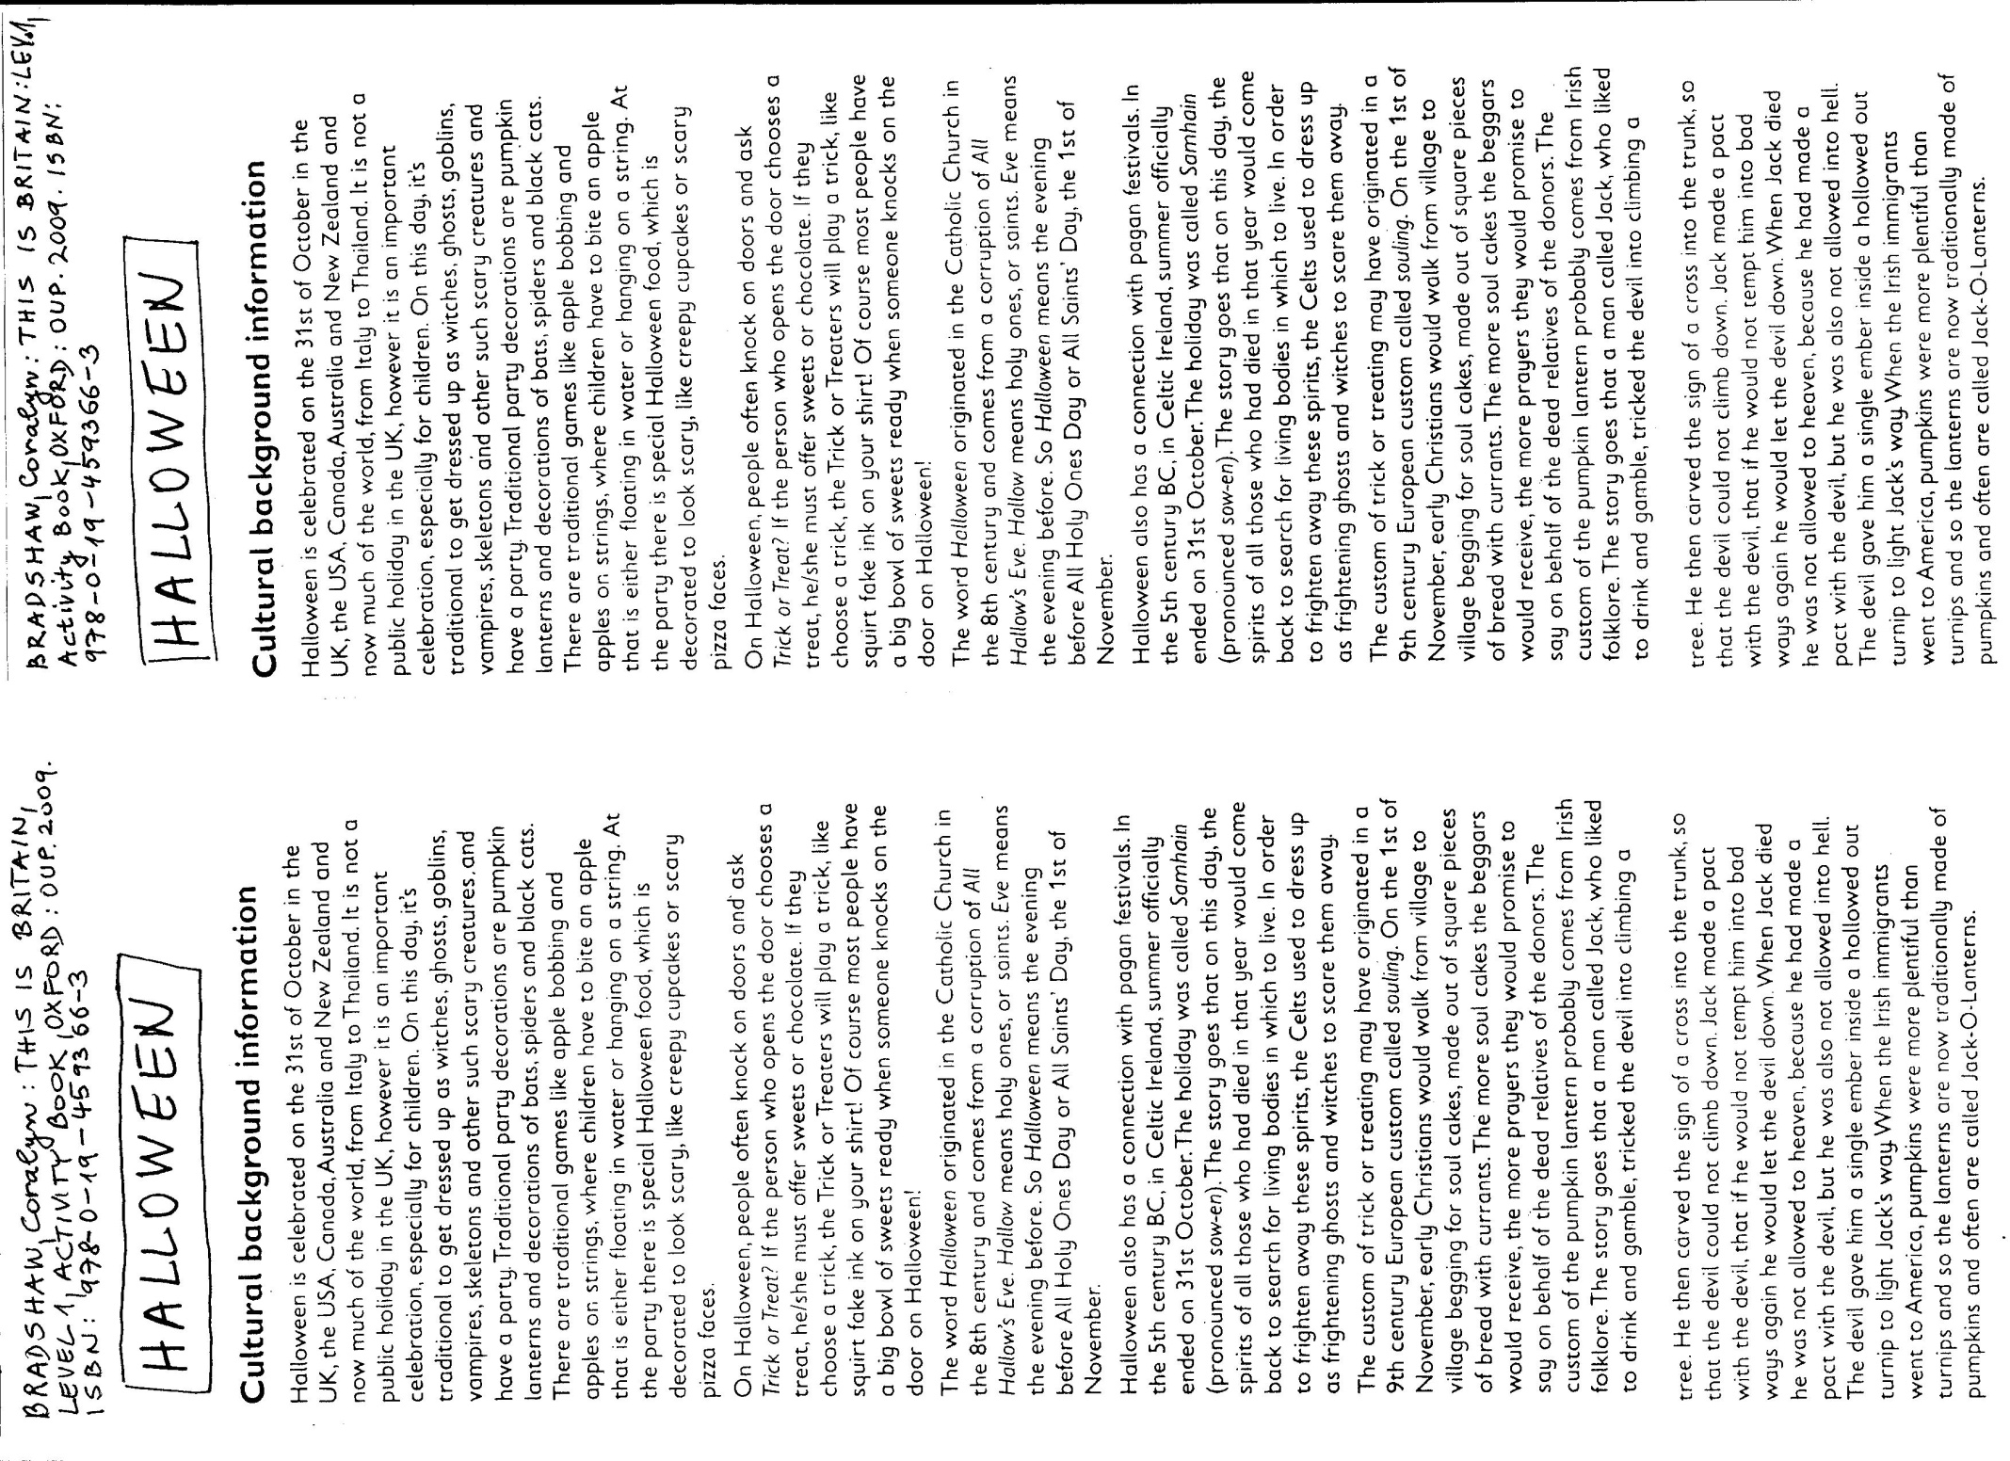
Notes:
Výchozí text pro žáky k vytištění. Na stránce jsou dva stejné texty!

